Slide 1
Catholic Central Quiz Bowl Camp
Religion

Slide 2
Religion v. Mythology V. Philosophy
Mythology is pretty much exclusively about stories
Philosophy is pretty much exclusively about theory
Religion is a combination of stories and theology

Slide 3
How to Be good at religion
1. RESOURCES
    Quizlet.com
    Quizlet.com
    Quizlet.com
    Quinterest.com
    Quizbowlpackets.com
    Wikipedia.com
    Grapesmoker.com
    Protobowl.com
  2. Learning the Bible (50% of religion)
    Look up books and people on quinterest
    Read the Bible (Acts, Esther)

Slide 4
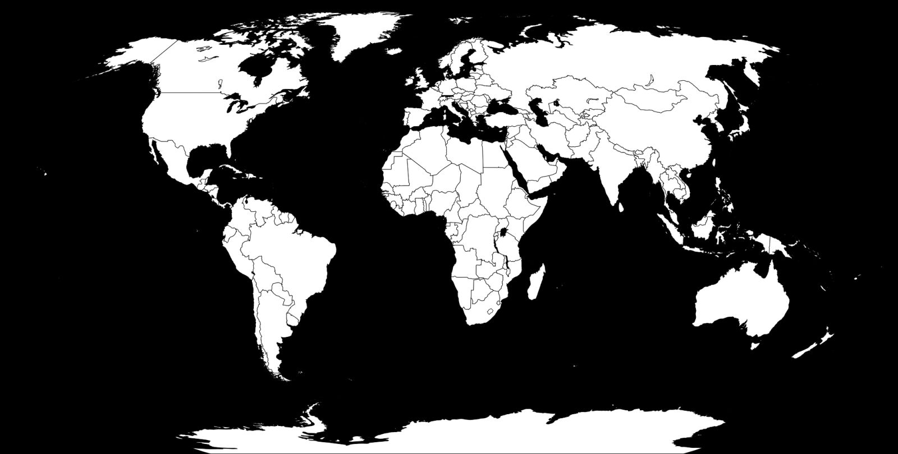
Judaism

Slide 5
Judaism
Abraham born c. 2100 BC
14 million followers
Scriptures ~ Torah (first 5 books of Christian Bible)
Holidays
    Hanukkah
      Celebrates the restoration of the Temple and the victory of Judas Maccabees over Antiochus IV (oil lasts eight days)
      Begins on 25 Kislev
      Songs sung ~ Hanerot Halalu, Ma’oz Tzur (Rock of Ages), Mi Y’maleil
      Money given as presents ~ “Gelt”
      Spinning of the Dreidel (gambling game) ~ Has sides with nun, gimel, hei, shin
      Also, eat jelly doughnuts (sufganiyot) and potato pancakes (latkes)

Slide 6
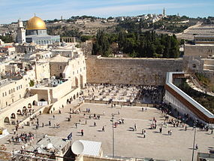
Notes:
Wikipedia.org

Slide 7
More Jewish Stuff
Rosh Hashanah
    Jewish New Year
    1 and 2 Tishrei (beginning of Ten Days of Awe)
    Followed by fast in remembrance of Gedaliah
    Sefer HaChaim (Book of Life) is opened by God
    Crumbs thrown into water during tashlikh ceremony
    Eat apples dipped in honey
    Shofar is blown
Yom Kippur
    Jewish Day of Atonement
    10 Tishrei
    25 hour fast
    Kapporot ritual ~ swinging a life chicken in the air
    Prayers ~ Al Cheit, Ashamnu, Ne’ilah, Kol Nidre (vows are annulled)
    The High Priest pronounces the Tetragrammaton
    Book of Jonah is read
    Priest enters the Holy of Holies
    Men wear a kittel

Slide 8
Even More Jewish stuff
Purim
    14 Adar
    Celebrates events of the Book of Esther where the heroes Esther and Mordecai foil the plots of the prime minister Haman
    They read the Book and when Haman’s name is read children scream and a gragger is shaken
    On leap years there is a “little” form
    In cities that were walled the “Shushan” form occurs
    Gifts are given ~ "mishloach manot“
    People get very intoxicated so that they can’t differentiate between “Blessed is Mordecai” and “Cursed is Haman”
    People give alms ~ Machatzit Hashekel (three-halves of a shekel)
    Plays called spiels
    Eat Fazuelos

Slide 9
Almost Done
Passover
      Celebrates the Exodus
      15 Nisan
      Remove chametz and eat matzah
      Seder meal
      The youngest person asks the “Four Questions” ~ "Why is this night different from every other night?“
      Beginning of the Counting of the Omer
      Hide afikomen
      Read Ezekiel’s vision of the dry bones
      Some use an orange to remember women rabbis

Slide 10
Islam

Slide 11
Islam
Founded by Muhammad in 622 AD during the Hijrah ~ (trip from Mecca to Medina)
Denominations
    Sunni ~ largest; recognize Abu Bakr and the “Rightly Guided” Caliphs
    Shia ~ smaller; recognize Ali
    Other ~ Ismailism, Druze, Twelvers, Seveners
  Five Pillars
    Shahadah (Testimony) ~ Islamic creed recited to become a Muslim
    Salat (Prayer) ~ Five times a days facing the Kaaba in Mecca (qibla)
    Zakat (Alms-Giving) ~ Required 2.5% charity
    Sawm (Fasting) ~ During Ramadan
      Includes the “Night of Power”
      Ends with Eid al-Fitr
      Tarawih prayer in the evenings

Slide 12
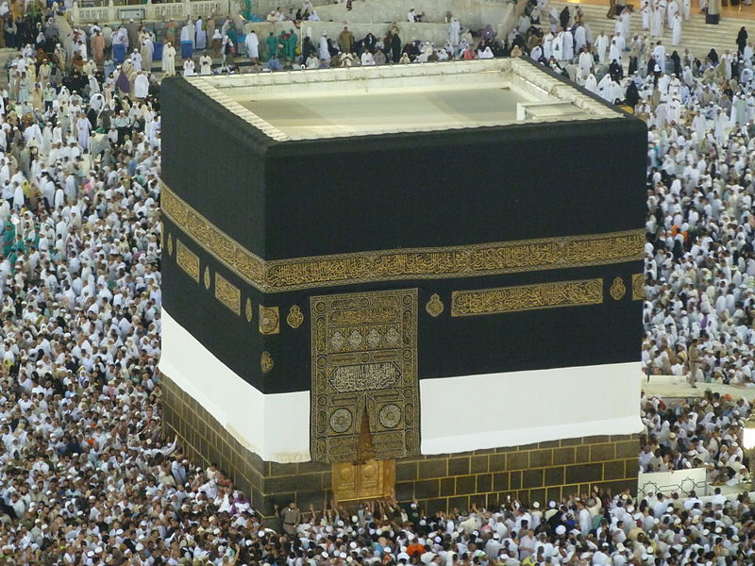

Slide 13
Islam Cont.
Hajj (Pilgrimmage) ~ Every Muslim able to must go to Mecca once during their life
      Hagar and Ishmael
      Visit the Kaaba ~ Tawaf (walk around)
      Celebrate Hagar visiting the Well of Zamzam
      Throw rocks at pillars to “stone the Devil”
      Men wear an ihram ~ white cotton robe
      Go to Mt. Arafat
      Camp at Mina
      Month of hajj ends with Eid al-Adha celebrating Abraham almost sacrificing Ishmael
Mosque
      Minarets are towers that surround it
      A muezzin stands at the top of the minaret and calls people to prayer through chanting

Slide 14
Zoroastrianism

Slide 15
Zoroastrianism
Persian religion founded in the second millenium BC by the prophet Zarathustra
      Nietzsche book
    Monotheistic religion ~ Ahura Mazda (Illuminating Wisdom)
      Opposed by Angra Mainyu/Ahriman
    Spenta Mainyu (Progressive Mentality) vs. Angra Mainyu (Destructive Mentality)
    Asha (truth) vs. Druj (falsehood)
    Scriptures ~ Avesta
      Gathas are most important part
      Also include Yastas and Vendidad
    Symbolized by Faravahar ~ Depiction of a fravashi (guardian angel)
    First man ~ Gayomart
    After death souls must cross the Chinvat Bridge
      The demon Vizaresh drags bad people to House of Lies (hell)
    Frashokereti ~ Renewal of the world
      Azi Dahaka will be released and the savior Saoshyant will be born of a virgin
      River of liquid metal that will carry the wicked to hell

Slide 16


Slide 17
Zoroastrianism Cont.
Zurvanism ~ Only major schism
    Say Zurvan is the parent of Ahura Mazda and Angra Mainyu
Wear a Kushi/Kushti
Daevas are evil demons
Creed ~ Fravarane
Towers of Silence
    Leave dead on top to be eaten by vultures
Fire Temples
    Has a sacred flame that is continuously burning

Slide 18
Sikhism

Slide 19
Sikhism
Indian monotheistic religion founded in the 15th century
    Waheguru is the one God
      Represented by the Il Onkar symbol
    Major in the Punjab region of India
    Founded by Guru Nanak ~ Slept with his feet facing the Kaaba
Led by a series of 10/11 gurus
    The “last” guru, Guru Gobind Singh, made the holy book, the Adi Granth, the 11th guru
The Adi Granth contains the teachings of all the gurus
    Assembled by Arjun Dev
    It is also known as Guru Granth Sahib
    Singing hymns from it is known as Naam Japo
    Another book is the Janamsakhis, the biography of Nanak
Temples are called gurdwaras
    Contains a communal kitchen called a Langar
    Most important one is the Golden Temple in Amritsar
Five Ks ~ Things Sikhs must always have
    Kesh (uncut hair), Kangha (comb), Kara (bracelet), Kachera (undergarments), Kirpan (daggar)

Slide 20
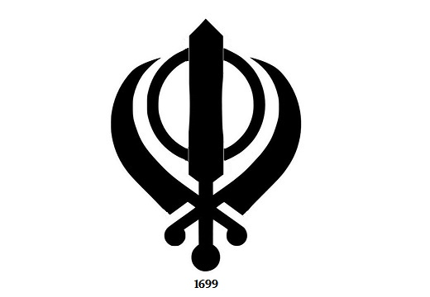
kHANDA

Slide 21
Sikhism Cont.
Khalsa ~ initiation/baptism by drinking amrit started by Gobind Singh
    Amrit is sugar water stirred in an iron bowl
    Must wear the Five Ks
    Take last name Singh (male) or Kaur (female)
    Started when Singh asked five people to come into his tent to be decapitated, but he just cut them and initiated them
    Recite the Five Banis every day
Has Three Pillars (just be familiar with terms)
    Naam Japo (contemplating the names of God)
    Kirat Karo (diligent work)
    Vand Chhako (sharing with the needy)
Five Thieves (like the Seven Deadly Sins) ~ Kaam, Krodh, Lobh, Moh, Hankaar
Five Virtues ~ Sat, Santokh, Daya, Nimrata, Pyaar
Charhdi Kalah ~ Must accept the will of God with a positive attitude

Slide 22
Baha'i

Slide 23
Baha’I
Monotheistic religion that believes all major faiths are revealed by one God
Founded by Baha’u’llah in the nineteenth century in Persia
    The Bab was a figure who prophesized the coming of Baha’u’llah
    Abdu’l-Baha was the son and successor of Baha’u’llah
    Abdu’l-Baha appointed Shoghi Effendi as his successor and made him the first Guardian
Believe in several Manifestations of God ~ major figures from Abrahamic and Vedic traditions
Major evangelization campaign called the Ten Year World Crusade
The Bab created the Baha’i calendar ~ 19 months of 19 days + 5 extra days
Symbols include the nine pointed star, the five pointed star (Haykal), the ringstone symbol, and the inscription of the Greatest Name
Scriptures ~ Book of Certitude is the most important
    Epistle to the Son of the Wolf, The Seven Valleys, Kitab-i-Aqdas ~ Most Holy Book (Baha’u’llah), Will and Testament (Abdu’l-Baha), God Passes By (Effendi)

Slide 24
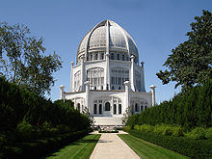

Slide 25
More Baha’i
Universal House of Justice in Haifa, Israel
Eight Houses of Worship
    Nine sided buildings
    Wilmette, Illinois
    Delhi, Inidia ~ Lotus Temple
Believe in one world government, language, etc.

Slide 26

Hinduism

Slide 27
Hinduism
Possibly the oldest continuous religion
Concepts (prevalent in all Vedic religions)
    Samsara ~ Cycle of life, death, and rebirth (reincarnation)
    Karma ~ Good and bad actions determine how one is reincarnated
    Moksha ~ Achievement of liberation from samsara
    Nirvana ~ State of being liberated from samsara
    Dharma ~ Truth, right way, moral truth
Scriptures
    Vedas
      Sanskrit
      Rig, Yajur, Sama, Atharva
    Sutras
      Collections of proverbs or aphorisms
      Means “thread” because the texts were sewn together
    Upanishads
      Commentaries on the Vedas
      Means “sitting near”

Slide 28
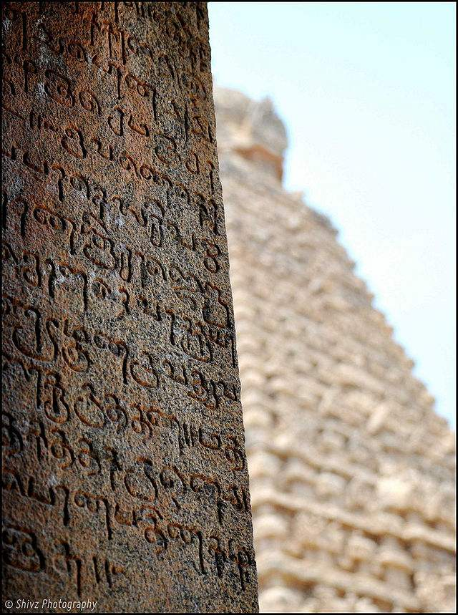

Slide 29
Hinduism cont.
Mahabarata
    Epic detailing the Kurukshetra War between the Kauravas and Pandavas
    Contains the Bhagavad Gita where Krishna gives advice to the Pandava prince Arjuna before a battle
Ramayana
    Epic about the avatar of Vishnu, Rama, who tries to rescue his wife Sita when she is taken by the king of Sri Lanka, Ravana
Holidays
    Diwali
      Festival of lights
      Light diyas (lamps)
      Celebrates Lakshmi ~ Wealth
      New fiscal year
      Days celebrate love between husband and wife and brother and sister

Slide 30
Hinduism Cont.
Holi
    Festival of colors
    Throw colored powder
    Starts with Holika bonfire
    Celebrates the defeat of the king Hiranyakashipu who wanted to be worshipped because he was indestructible. His sister Holika tried to kill his son Prahlada who worshipped Vishnu, but she got burned and Hiranvakashipu got killed by Vishnu.

Slide 31
Buddhism

Slide 32
Buddhism
Founded 6th – 4th century BC by the Prince Siddhartha Gautama who achieved enlightenment while sitting under the Bodhi tree
    Broke off from Hinduism (kinda)
Four Noble Truths ~ Central beliefs
    All about dukkha (suffering) ~ Where it comes from (desires), how to get rid of it), etc.
    Include the way to get rid of suffering, the Eightfold Path/Middle Path
      Represented by dharma wheel
      Includes “virtues” related to wisdom, ethical conduct, and concentration
Cessation of existence
Three Jewels
    Buddha, Dharma (teachings), Sangha (community)
Has two major schools and lots of subsects
    Theravada (Teaching of the Elders)
      Oldest school
      Pali Canon/Tipitaka (Three Baskets)

Slide 33


Slide 34
Buddhism Cont.
Mahayana (Greater Vehicle)
    Believe in Bodhisattvas ~ People who do not enter nirvana in order to help others get there
    Includes Zen and Pure Land Schools
    Scriptures include several sutras: Perfect Wisdom, Platform (Zen), Lotus, Nirvana
Zen
    Brought to China by the monk Bodhidharma
    Laṅkāvatāra Sūtra and Flower Sermon (Buddha) were important in its development
    Koans ~ Paradoxical sayings that aid in meditation
      Contained in the Blue Cliff Record and The Gateless Gate
    Zazen/shikantaza (meditation)
    Schools ~ Rinzai, Soto, Sanbo Kyodan

Slide 35

Jainism
Notes:
Made using ace pp by

Slide 36
Jainism
Major belief is ahimsa (nonviolence)
Important figures are the 24 Tirthankaras (Ford-Makers)
    Last one was Mahavira
Major sects are the Digambara (sky-clad), and Svetambara (white-clad)
    Disagree on whether Mallinath was a man or woman
The Agamas are the most important scriptures
    Book of Reality is another thing
Symbolized by a hand with a wheel
    Another symbol is the swastika
Believe in Anekantavada ~ Truth can be approached in more than one way
Monks adhere to the Five Great Vows

Slide 37

Taoism

Slide 38
Taoism/Daoism
Chinese philosophy/religion founded by Laozi
    Another major contributor to it was Zhuangzi
    All about harmony of life with the Tao (way)
Its “holy book,” written by Laozi, is the Tao Te Ching
Chief concept is wu-wei, “without action”
    Don’t disturb the flow of the universe; go with the flow
    Associated with being yielding like water or being like an uncut block
Three Treasures ~ compassion, frugality, and humility
The Five Pecks of Rice rebellion was led by one of its Celestial Masters
Deities include the Jade Emperor and the Three Pure Ones

Slide 39


Slide 40

Confucianism

Slide 41
Confucianism
Chinese semi-religious philosophy based on the teaching of Confucius, who lived from 551-479 BC
    The Analects are mostly attributed to him
Has Five Classics ~ I Ching, Classic of Poetry, Book of Documents, Book of Rites, Spring and Autumn Annals
Highly emphasizes filial piety/respect for elders and the rectification of names
    Five Bonds ~ ruler/subject, father/son, husband/wife, older brother/younger brother, friend to friend
Five Constants ~ Ren, Yi, Li, Zhi, Xin
Sizi (four virtues) ~ Zhong, Xiao, Jie, Yi
Confucius came up with the “Silver Rule,” which is like the Golden Rule but in the negative ~ Don’t do to others what you don’t want them to do to you
Mencius was the most important after Confucius (more Neo-Confucian though)
    He wrote a book named after him

Slide 42
