Slide 1
Intro to Philosophy
Ean Maloney
DCC Quiz bowl camp 2017

Slide 2
An overview
Presocratic: the beginning of time – 469 BC
Ancient: 469 BC – 476 AD
Medieval: 476 AD – 1600s
Modern: 1620ish-1850
Contemporary: 1850-…

Slide 3
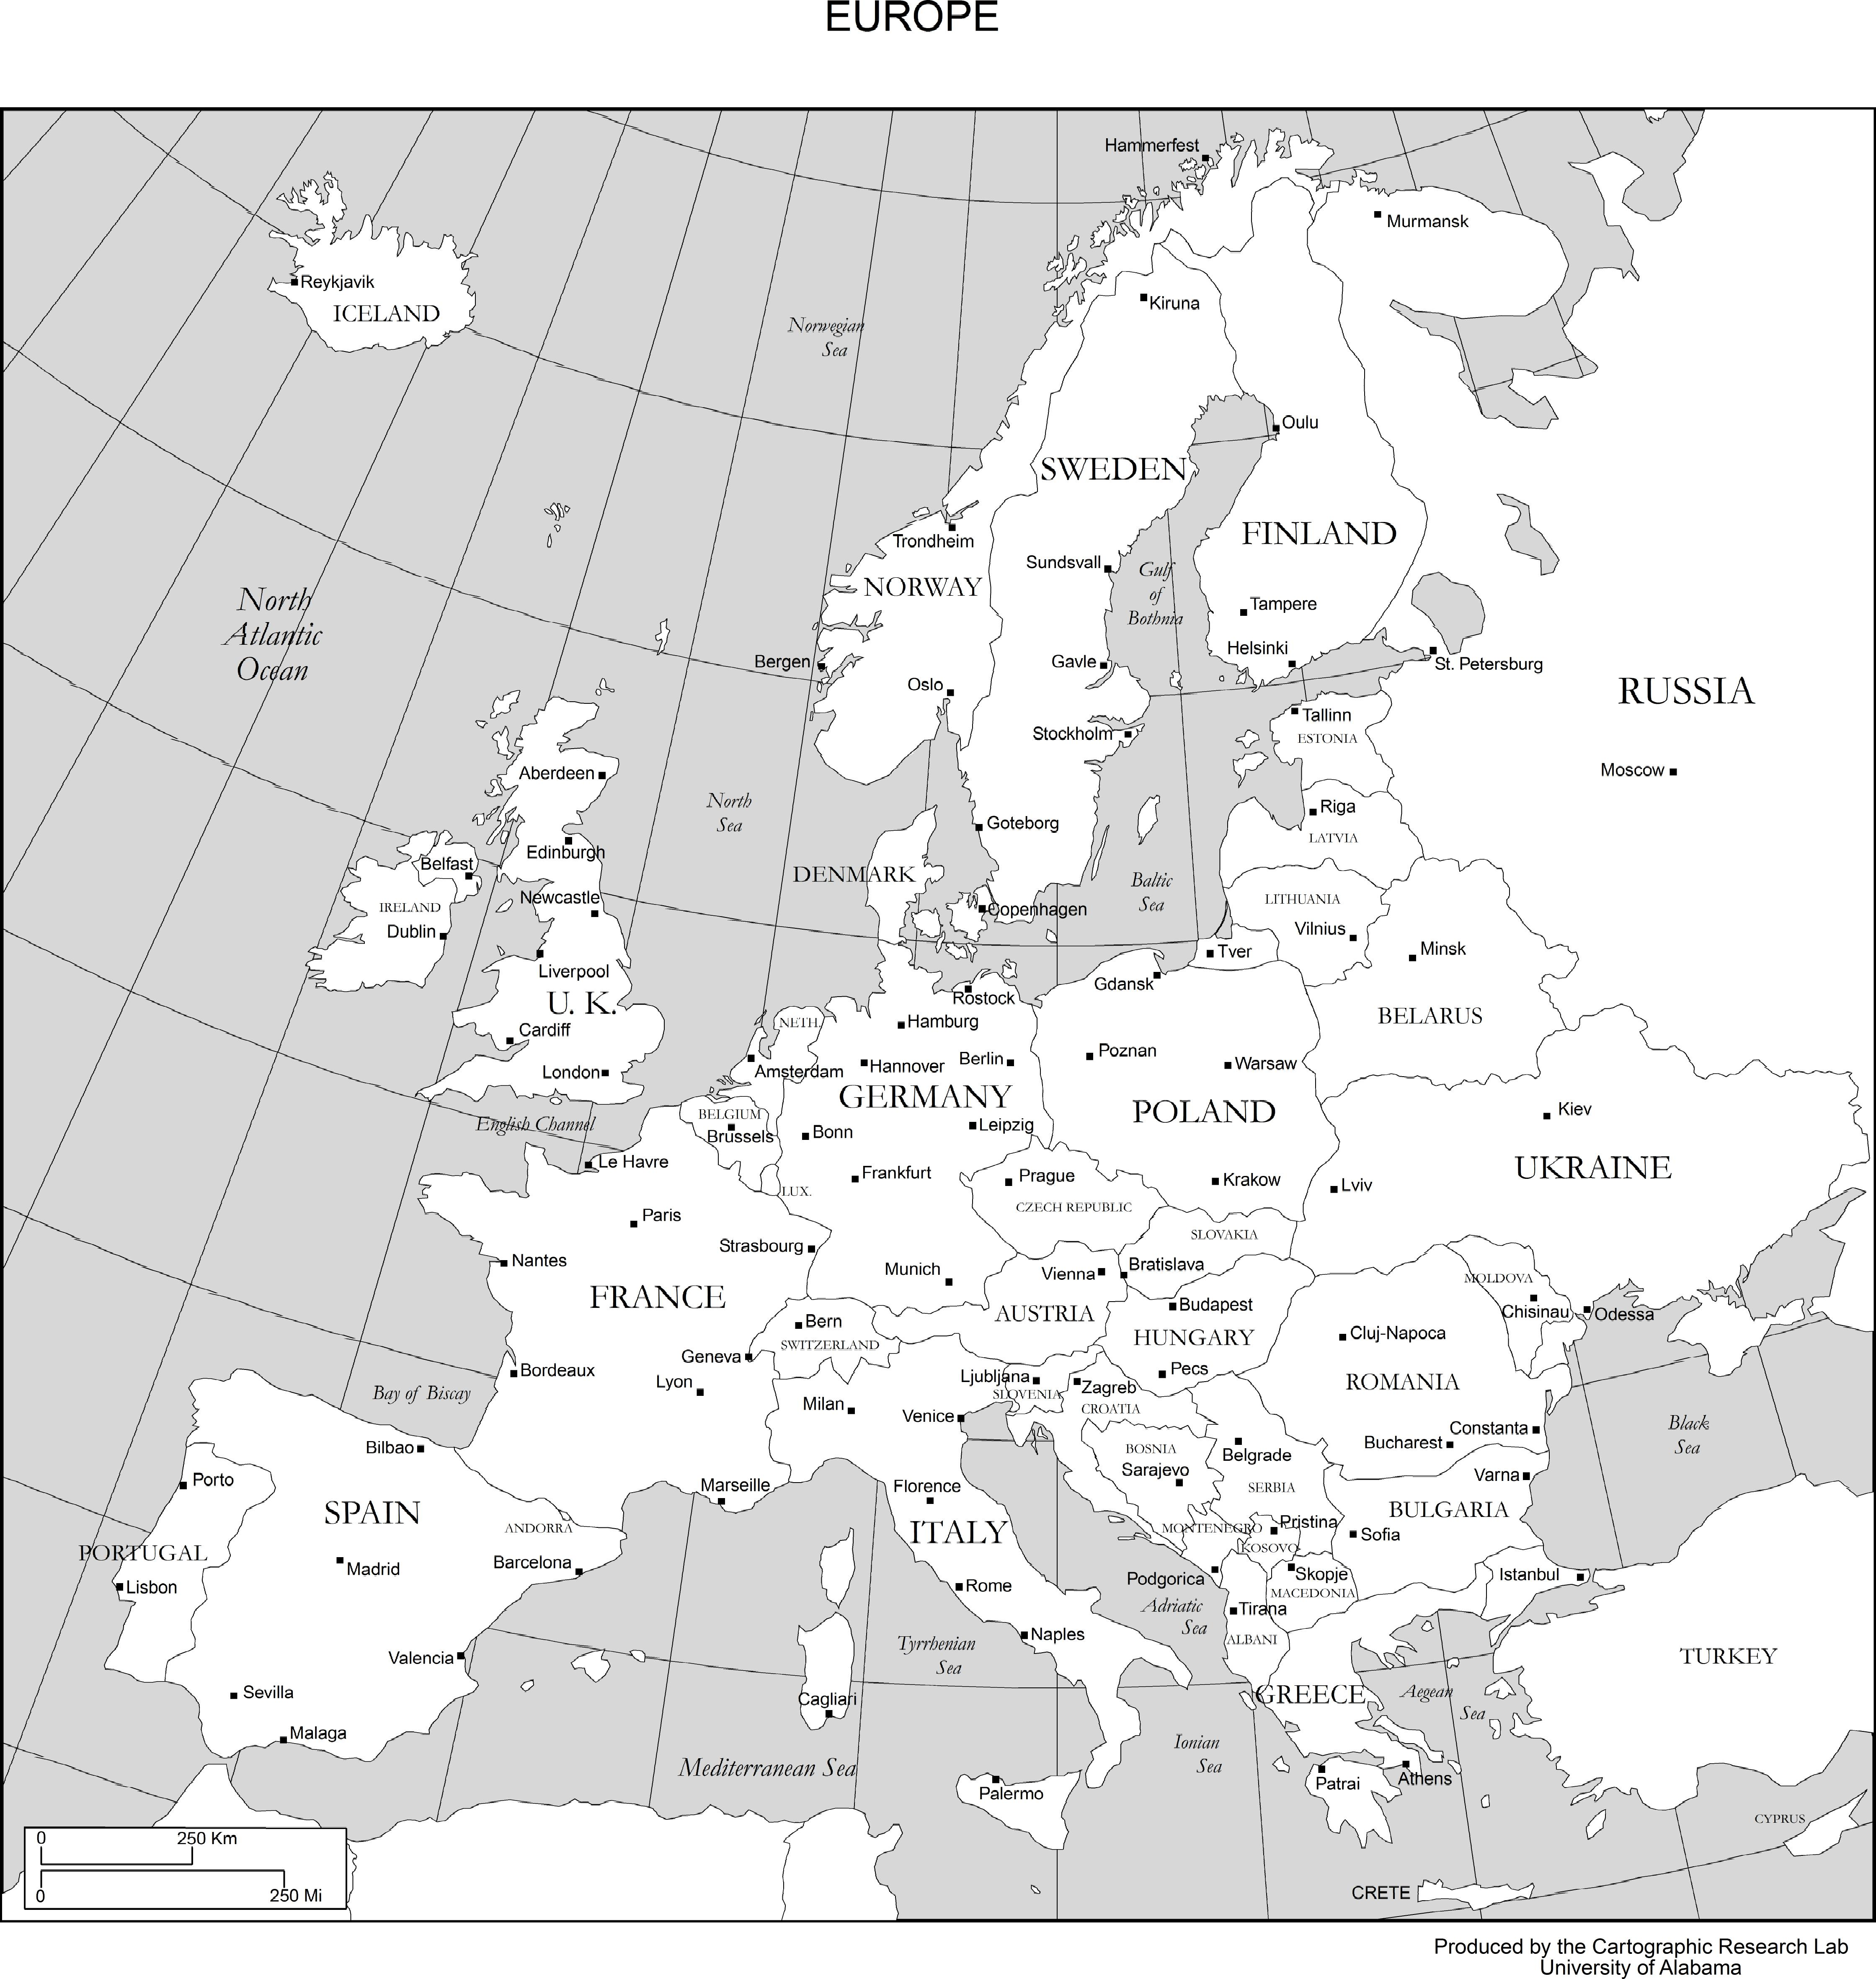
Socrates 470-399 BC
Plato 428-348 BC
Aristotle 384–322 BC

Slide 4
Classical greek
Socrates
  Sophism – philosophy and rhetoric
  Trial in Athens
    Apology
  Executed by hemlock
  Socratic method – negative hypothesizing
    Elenchus
Plato
  Student of Socrates
  The Academy
  Dialogues
    Apology
    Euthyphro
    Republic
    Symposium
    Timaeus
  Knowledge as recollection
  Theory of forms
Aristotle
  Student of Plato
  The Lyceum
  Writings
    Physics
    Metaphysics
    Nicomachean Ethics
    Poetics
  Four Causes
  Eudaimonia

Slide 5
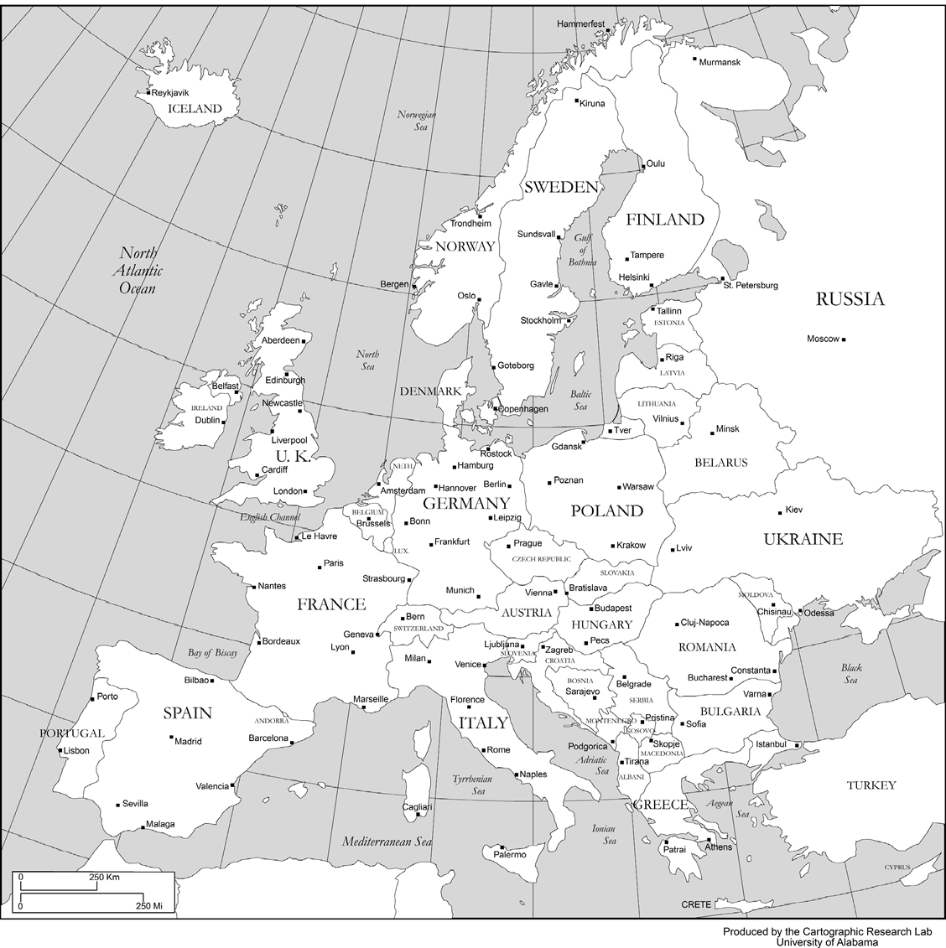
Thomas Aquinas 1225 – 1274 AD
Seneca 4 BC – 65 AD
Marcus Aurelius 121 – 180 AD
Boethius 480 – 524 AD

Slide 6
Roman And Medieval
Seneca
  Stoicism
Marcus Aurelius
  Meditations
Boethius
  The Consolation of Philosophy
Thomas Aquinas
  Scholasticism
  Summa Theologica
    Quinque viae
      Motion, causation, contingency, degree, teleological (design)
  Summa Contra Gentiles
  Ontological argument – Anselm of Canterbury

Slide 7

Francis Bacon 1561 – 1626
Thomas Hobbes 1588 - 1679
John Locke 1632 – 1704
George Berkeley 1685 - 1753
David Hume 1711 – 1776
Immanuel Kant 1724 – 1804
Gottfried Leibniz 1646 - 1716
Rene Descartes 1596 – 1650
Montesquieu 1689 - 1755
Jean-Jacques Rousseau 1712 – 1778

Slide 8
Enlightenment
Francis Bacon
  Scientific method + induction (specific → general)
  Empiricism
  Novum Organum
Rene Descartes
  Meditations on First Philosophy
    Skepticism
  Discourse on Method
  Rationalism
    Reason + deduction
  Mind body dualism
Gottfried Leibniz
  Calculus
  Optimism and rationalism
  New Essays on Human Understanding
    Innate ideas
  Monadology
    Monad = soul
  Theodicy
    Best of all possible worlds

Slide 9
Enlightenment
Thomas Hobbes
  Leviathan
    Social contract theory
    State of nature
      "war of all against all"
      “solitary, poor, nasty, brutish, and short”
    Absolute sovereignty
John Locke
  An Essay Concerning Human Understanding
    “tabula rasa”
    Primary and secondary qualities
  Two Treatises of Government
    Natural rights – life, liberty, property
    Separation of powers
Montesquieu
  Separation of powers (3)
  The Spirit of the Laws
    Motivations of monarchy, republic, and despotism – honor, virtue, fear
    Climate and society
Jean-Jacques Rousseau
  The Social Contract
    General will, republicanism
    State of nature → priv. prop./div. of labor → society
    "Man is born free, and everywhere he is in chains. Those who think themselves the masters of others are indeed greater slaves than they."

Slide 10
enlightenment
George Berkeley
  A Treatise Concerning the Principles of Human Knowledge
    Immaterialism/subjective idealism
      “To be is to be perceived.”
      "Ideas can only resemble ideas.“
  Three Dialogues between Hylas and Philonous
    “There is no tree.”
  The Analyst
    “Ghosts of departed quantities.”
  Tar water
David Hume
  A Treatise of Human Nature
    Problem of induction – empiricism?
    Sentimentalist
  An Enquiry Concerning Human Understanding
    Hume’s fork – relations of ideas/matters of fact
    Kant’s “dogmatic slumber”
    Missing shade of blue
  Virtue ethics
  Dialogues Concerning Natural Religion
    Pamphilus, Cleanthes, Philo, Demea

Slide 11
Enlightenment
Immanuel Kant
  "Enlightenment is man's emergence from his self-incurred immaturity.“
  Critique of Pure Reason
    a priori and a posteriori knowledge
    Analytic and synthetic judgements
      Synthetic a priori judgements
  Groundwork of the Metaphysics of Morals and Critique of Practical Reason
    Categorical imperative – “Act only according to that maxim whereby you can, at the same time, will that it should become a universal law.”

Slide 12

Jeremy Bentham 1748 – 1832
J.S. Mill 1806 – 1873
Georg Hegel 1770 – 1831
Auguste Comte 1798 - 1857

Slide 13
Early Modern
Jeremy Bentham
  Utilitarianism and the greatest happiness principle
Georg Hegel
  Phenomenology of Spirit
    Master-slave dialectic
  Elements of the Philosophy of Right
  Thesis-antithesis-synthesis
Auguste Comte
  Positivism
    Sense experience
  Social science
  Religion of humanity
J.S. Mill
  On Liberty
  Utilitarianism
    “It is better to be a human being dissatisfied than a pig satisfied.”
  Principles of Political Economy

Slide 14


Bertrand Russell 1872 - 1972
Ludwig Wittgenstein 1889 – 1951
C.S. Peirce 1839 -1914
William James 1842 – 1910
Martin Heidegger 1889 - 1976
Friedrich Nietzsche 1844 - 1900

Slide 15
late Modern
Friedrich Nietzsche
  The Birth of Tragedy
    Apollonian and Dionysian
  The Gay Science
    Eternal recurrence
    “God is dead.”
  Thus Spoke Zarathustra
    Ubermensch
  Beyond Good and Evil
    Will to power
Martin Heidegger
  Being and Time
    What is Being?
    Dasein – human experience of Being
Bertrand Russell
  Analytic philosophy
  Principia Mathematica
    Whitehead
  “On Denoting”
  “Why I am not a Christian.”
  Russell’s teapot
    Unfalsifiability
Ludwig Wittgenstein
  Tractatus Logico-Philisophicus
  Philosophical Investigations

Slide 16
Pragmatists
William James
  The Principles of Psychology
  The Varieties of Religious Experience
    Existential judgement v. proposition of value
    Gifford lectures
  Pragmatism: A New Name for Some Old Ways of Thinking
  “Cash value”
C.S. Pierce
  Pragmatic Maxim – “Consider what effects, that might conceivably have practical bearings, we conceive the object of our conception to have. Then, our conception of these effects is the whole of our conception of the object.”

