Slide 1
Particle Physics
DCC Academic Team Camp 2017

Slide 2
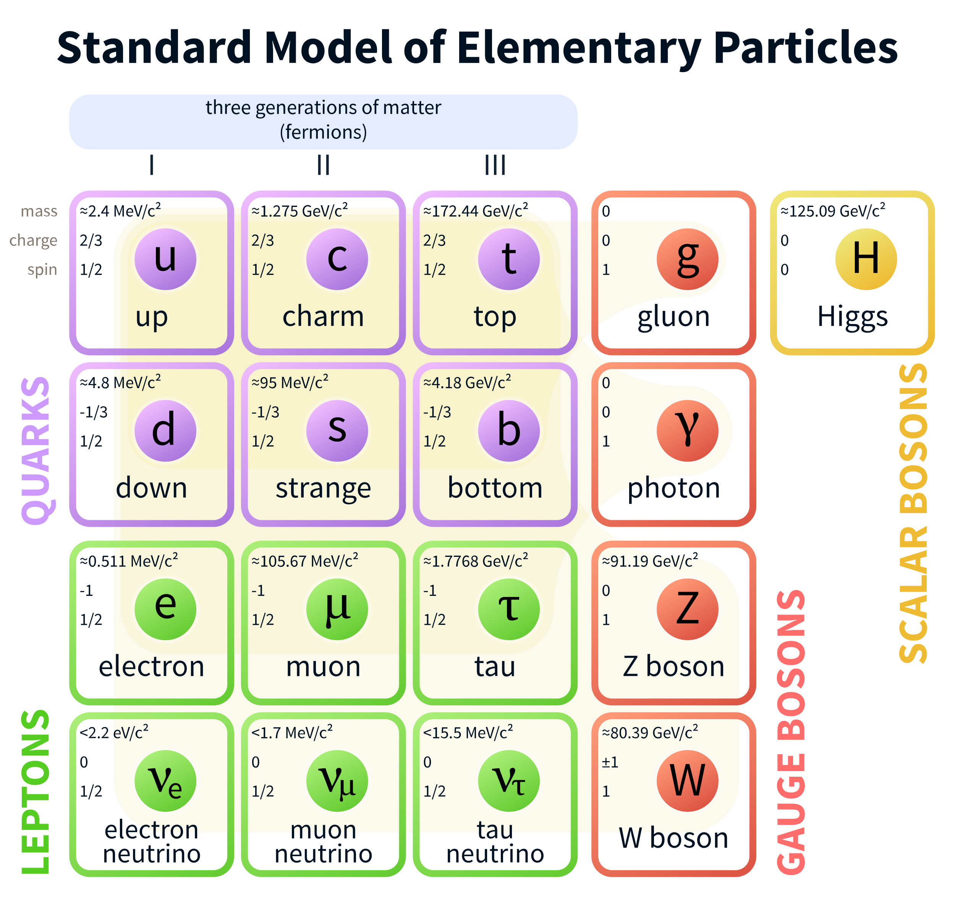
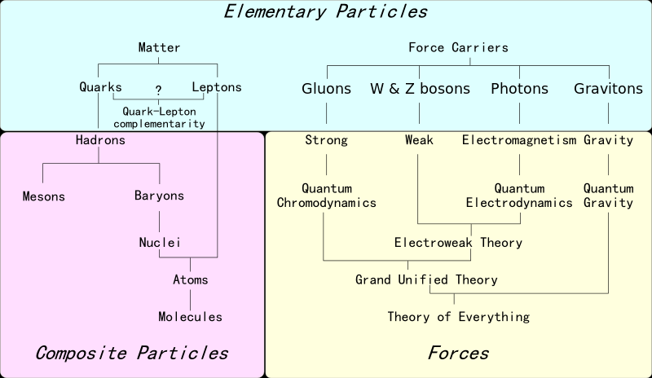
An Overview
Notes:
By MissMJ [CC BY 3.0 (http://creativecommons.org/licenses/by/3.0) or Public domain], via Wikimedia Commons
By Headbomb (Own work) [CC BY-SA 3.0 (http://creativecommons.org/licenses/by-sa/3.0) or GFDL (http://www.gnu.org/copyleft/fdl.html)], via Wikimedia Commons

Slide 3
How Do We Classify Particles?
Fundamental or Composite (Hadrons)
Spin
  fermion or boson
Other Properties
  flavor/color

Slide 4
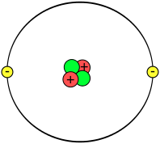
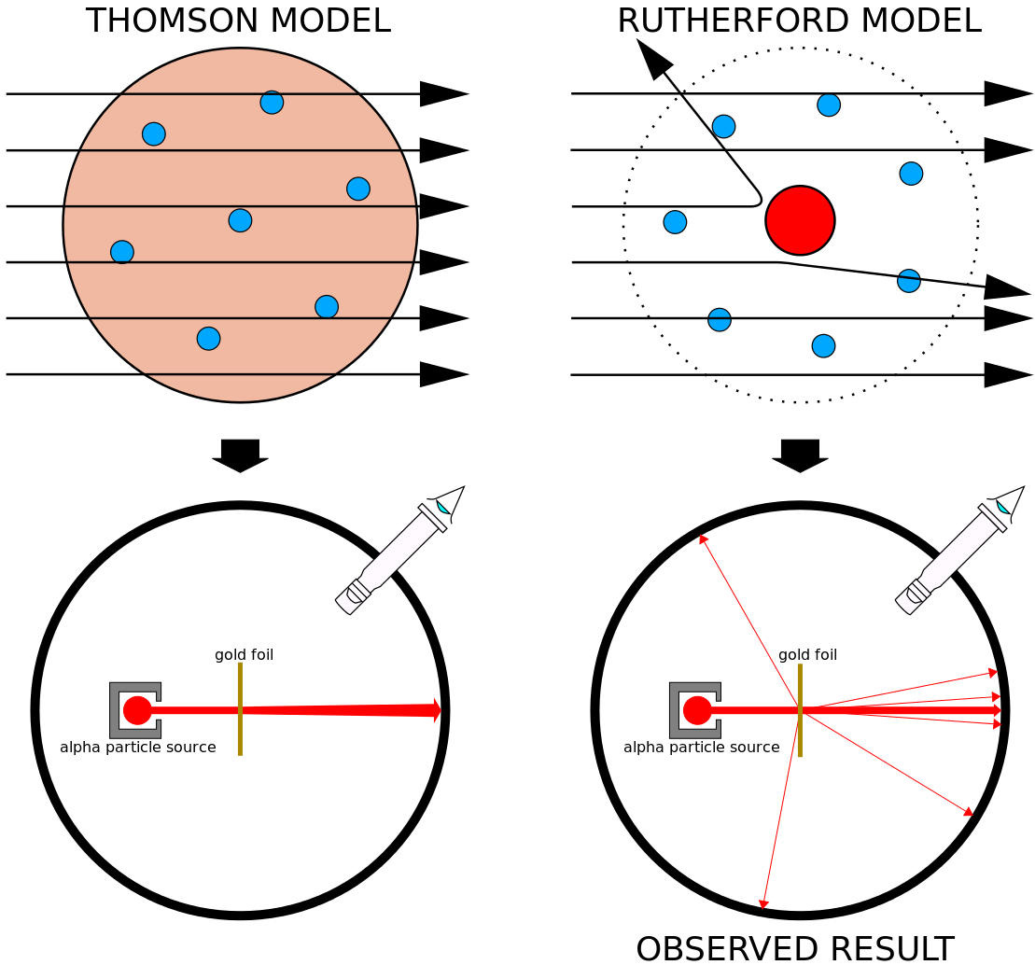

Atomic Level
Nucleus
  Rutherford gold foil/Geiger-Marsden experiment
  protons/neutrons
  strong nuclear force
Electron Cloud
  Heisenberg Uncertainty
Notes:
Intersection of Physics and Chemistry
By Svdmolen/Jeanot (converted by King of Hearts) (Image:Atom.png) [GFDL (http://www.gnu.org/copyleft/fdl.html) or CC-BY-SA-3.0 (http://creativecommons.org/licenses/by-sa/3.0/)], via Wikimedia Commons
By Kurzon (Own work) [CC BY-SA 3.0 (http://creativecommons.org/licenses/by-sa/3.0)], via Wikimedia Commons
By Carlo Barraco [GPL (http://www.gnu.org/licenses/gpl.html)], via Wikimedia Commons

Slide 5
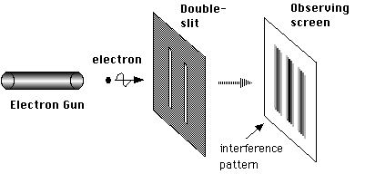
Wave-Particle Duality
Electrons
  J.J. Thomson – travel through vacuum tubes
  double-slit experiment
  photons, etc.

Slide 6
Spin
Intrinsic Angular Momentum
Stern-Gerlach experiment
  shoot Ag atoms through an inhomogeneous magnetic field
  atoms deflect up or down
Fermions – quarks, electrons (leptons)
Bosons – photons, higgs boson, other gauge bosons
Notes:
Pauli exclusion

Slide 7
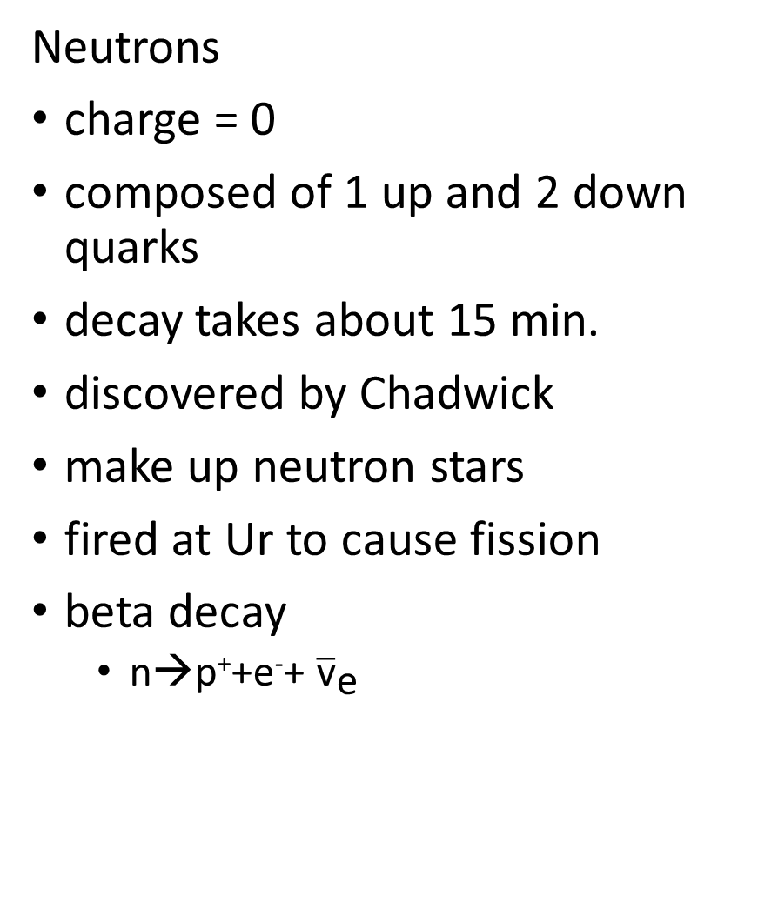
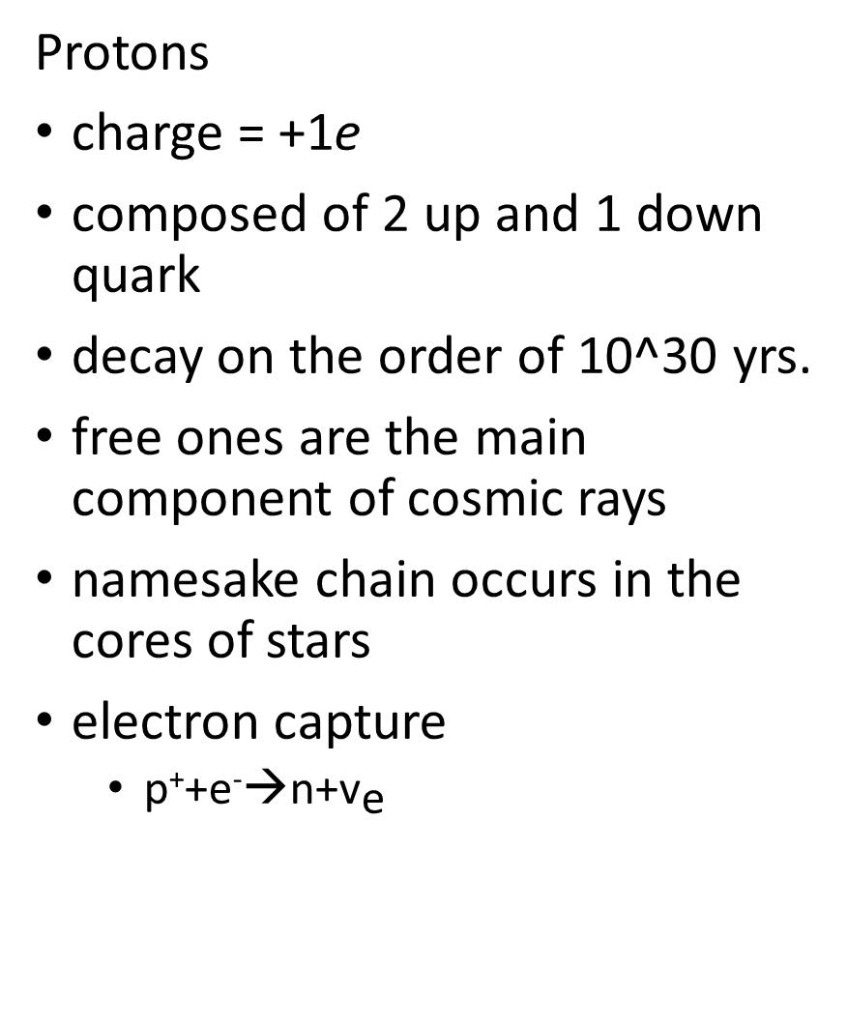
Protons
charge = +1e
composed of 2 up and 1 down quark
decay on the order of 10^30 yrs.
free ones are the main component of cosmic rays
namesake chain occurs in the cores of stars
electron capture
  p⁺+e⁻→n+${\text{v}}_{\text{e}}$
Neutrons
charge = 0
composed of 1 up and 2 down quarks
decay takes about 15 min.
discovered by Chadwick
make up neutron stars
fired at Ur to cause fission
beta decay
  n→p⁺+e⁻+ ${\overline{\text{v}}}_{\text{e}}$

Slide 8
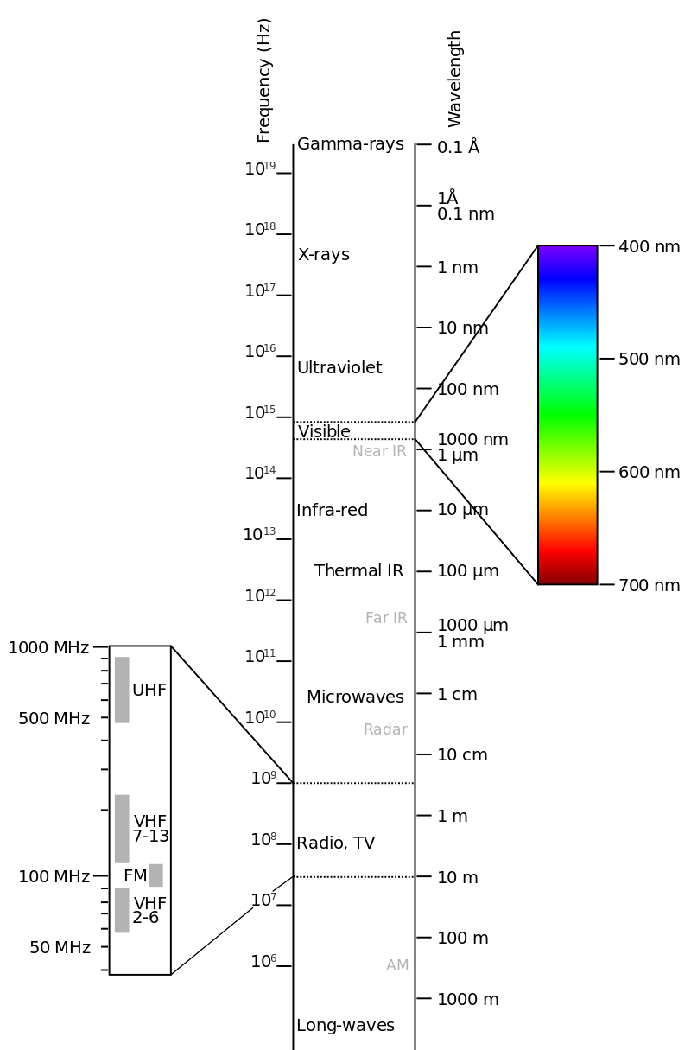
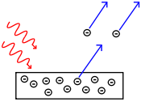
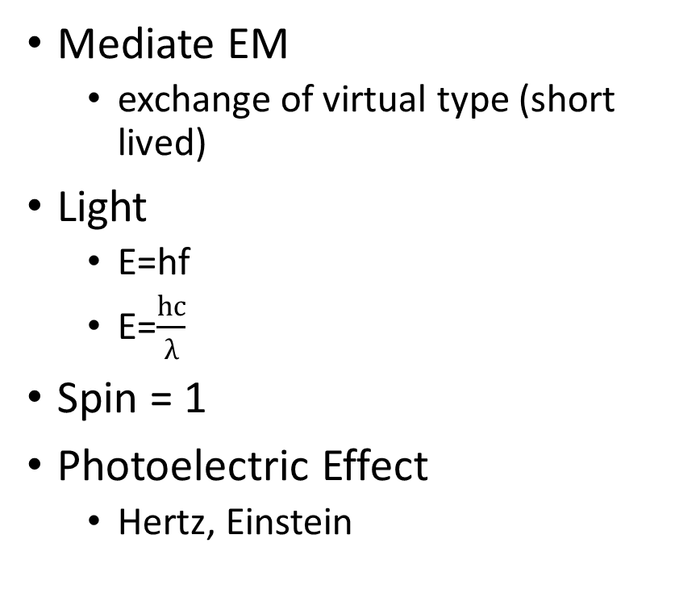
Photons
Mediate EM
  exchange of virtual type (short lived)
Light
  E=hf
  E=$\frac{hc}{λ}$
Spin = 1
Photoelectric Effect
  Hertz, Einstein
Notes:
By Victor Blacus (SVG version of File:Electromagnetic-Spectrum.png) [CC BY-SA 3.0 (http://creativecommons.org/licenses/by-sa/3.0)], via Wikimedia Commons
By Wolfmankurd (en:Inkscape) [GFDL (http://www.gnu.org/copyleft/fdl.html) or CC-BY-SA-3.0 (http://creativecommons.org/licenses/by-sa/3.0/)], via Wikimedia Commons

Slide 9
Quarks
Meson, Baryon, Tetraquark, Pentaquark
  Protons and neutrons
Theorized by Gell-Mann and Zweig
Discovered via deep inelastic scattering experiments at Stanford (SLAC)
6 Flavors
  up, down, charm, strange, top, bottom
Color Confinement
  cannot exist in isolation
Asymptotic Freedom
Quark-Gluon Plasma

Slide 10
Gluons Higgs Boson
Color Charge (8 Var.)
Form Glueballs
Mediate Strong Force between Quarks
Electric Charge, Color Charge, Spin = 0
  only scalar boson
Higgs Field
  causes fundamental particles to have mass
CERN-LHC

Slide 11
Neutrinos Antiparticles
Leptons
3 Flavors
  electron, muon, tau
  oscillation – MSW effect
Pauli
Sun produces a bunch
  solar neutrino problem
Same Mass, Spin
Opposite Electric Charge
Proton – Antiproton
Neutron – Antineutron
Electron – Positron
Photon – Photon

Slide 12
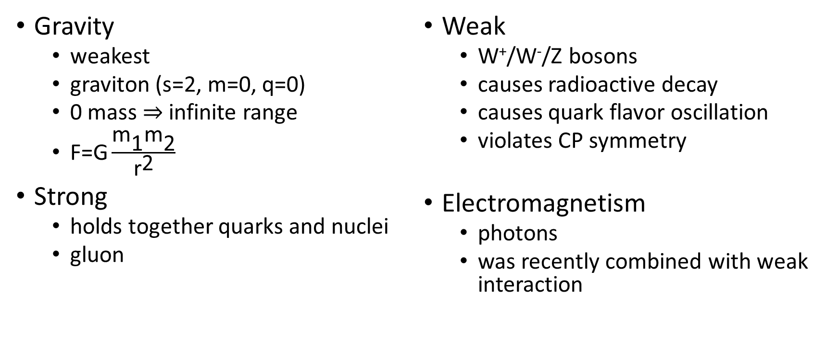
Fundamental Forces
Gravity
  weakest
  graviton (s=2, m=0, q=0)
  0 mass $⇒$ infinite range
  $\text{F}\text{=}\text{G}\frac{{\text{m}}_{\text{1}}{\text{m}}_{\text{2}}}{{\text{r}}^{\text{2}}}$
Strong
  holds together quarks and nuclei
  gluon
Weak
  W⁺/W⁻/Z bosons
  causes radioactive decay
  causes quark flavor oscillation
  violates CP symmetry
Electromagnetism
  photons
  was recently combined with weak interaction

