Slide 1
DEITIES AND MAJOR STORY ARCS IN WORLD MYTH

Slide 2
Studying Myth
As with all quizbowl, notecarding questions from packets and tossup databases is a solid strategy for learning and remembering myth
However, because mythology is fundamentally a collection of stories meant to be passed down through generations, it is naturally very engaging and easy to learn through reading/listening
  Reading Wikipedia articles and sacred texts will greatly enhance your depth of knowledge

Slide 3
GREEK
Know the Olympians: Zeus, Poseidon, Hera, Demeter, Athena, Hephaestus, Dionysus, Apollo, Artemis, Hermes, Ares, Aphrodite
Also know:
  Hades- major god, came up when I played a good amount
  Persephone- goes along with Hades, her abduction is a good topic to be familiar with
  Minor gods: Hestia, Pan, Priapus
  Titans, Gaia, Uranus
  Story arcs: Trojan War, Titanomachy, Gigantomachy

Slide 4
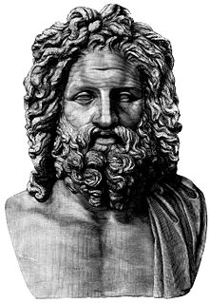
ZEUS
suckled by the goat Amalthea on Mount Ida
Rhea's dancers, the Kuretes, danced and made loud noises with their spears and shields to drown out the sound of him crying
When Rhea was pregnant with him, she pressed her fingers into the earth on Mount Ida to create the dactyls
The Phrygian couple Baucis and Philemon gave him and Hermes hospitality
  rewarded them by turning them into an oak and linden tree
hung Hera from the clouds with anvils attached to her feet
gave Europa a necklace forged by Hephaestus, Laelaps, Talos, and a javelin that never missed
worshipped at Dodona with the epithet "Naios", with the female consort Dione
Tityos
  his giant son with Elara, whom he buried deep in the Earth to hide from Hera
  he split her womb and was carried to term by Gaia
  tried to rape Leto on behest of Hera, and was slain by Artemis and Apollo
  punished in Tartarus by being strapped to the ground and having his liver eaten every day by two vultures

Slide 5
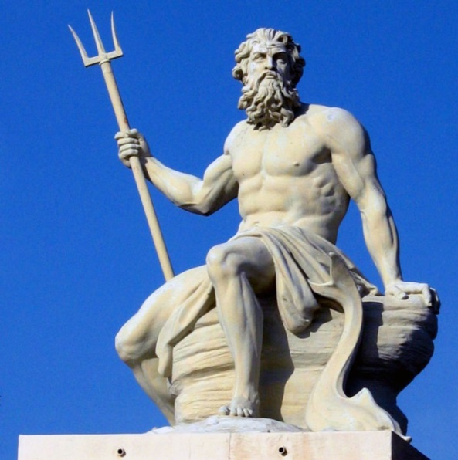
POSEIDON
In some accounts, he was hidden among a flock of sheep by Rhea, who gave a colt to Cronus to devour instead
  raised by the Telchines on Rhodes
identified with Erechtheus
  killed Erechtheus II with his trident (or by swallowing him with the earth or having Zeus strike him with lightning) after Erechtheus killed his son Eumolpos in battle
  the Erechtheion is dedicated to him and Athena
    contains the spot he struck with his trident to create a saltwater spring
built the walls of Troy with Apollo for King Laomedon
  This was Zeus's punishment for him after he and Apollo participated in Hera's revolt against Zeus
Saved Amymone from a satyr who was trying to rape her, and carried her off for himself

Slide 6
POSEIDON
raped the nymph Caenis, then fulfilled her request be transformed into a man so she couldn't be raped ever again
  she became the warrior Caeneus who killed the centaur Latreus after he mocked Caeneus's origin as a woman
  in revenge, the centaurs crushed Caeneus with pine trunks, as he was invulnerable to weapons
disguised himself as the river god Enipeus, who was sought by the married mortal Tyro
  Enipeus had refused her advances, so Poseidon took his form out of his lust for Tyro
Notable Children:
  with Demeter (after mating with her in horse form)- Despoina and Arion- the talking horse
  Benthesikyme- married the first king of Ethiopia, Enalos, and raised Eumolpos
  with Chione (daughter of Boreas)- Eumolpos
    raised by Benthesikyme after Chione threw him into the sea and then washed ashore in Ethiopia
    married one of the daughters of Enalos and Benthesikyme
    was a priest of Demeter in Eleusis, sided with that city during a war with Athens
  with Medusa- Pegasus and Chrysaor
    they sprang from her neck after Perseus beheaded her
  with Amymone- Nauplius
  with Tyro- Pelias and Neleus

Slide 7
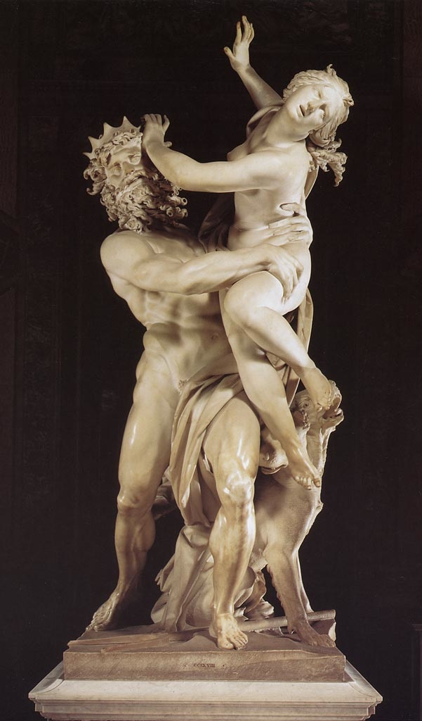
HADES
Leuce- nymph and daughter of Oceanus abducted by Hades
  when she died, he turned her into a white poplar tree in the Elysian fields
  Heracles used this tree to crown himself upon his return from the underworld
Minthe- naiad associated with the river Cocytus
  impressed by Hades's golden chariot, and they were about to get it on until Persephone transformed her into the mint plant
Persephone
  was gathering flowers in varying locations, which include near Enna in Sicily, Attica (near Athens), the Nysian plain in Boeotia, Crete, Eleusis, or the probably mythical Nysion
  The Syracusan naiad Cyrane/Kyrane tried to stop her abduction, but failed and dissolved into a pool of her own tears
  The old woman Baubo tried to comfort Demeter after the abduction
    lifted her skirt to reveal Demeter's son Iacchus
  the daughters of Achelous were given wings by Demeter to search for her, but failed and became the Sirens
  Ascalaphus, the caretaker of Hades's orchard, reported that Persephone ate a pomegranate in the underworld, for which Demeter buried him under a rock
    was later freed by Heracles, but was then turned into an owl by Demeter
  The swineherd Eubuleus and shepherd Eumolpus witnessed her abduction
    some of Eubuleus's pigs were swallowed by the Earth- precedent for pig burying rituals at Thesmosphoria and Eleusis
  in some versions, Hecate rescues her

Slide 8
HADES
Cult
  members averted their faces when making sacrifices to him, and hit the ground with their hands to make sure he would hear them
    sacrificed black sheep to him
  referred to as "The Rich One", Clymenus, Polydegmon(receiver of many), and Eubuleus to avoid saying his name
    called Dis Pater and Orcus by the Romans
his cowherd Menoetes/Menoetius had his ribs crushed by Heracles on the island of Erytheia after wrestling with him
Heracles wounded him when he was defending Pylos with the Pylians
Aeacus- one of the three judges- held his keys
in the Suda, he is father of Macaria ( not to be confused with the daughter of Heracles)
the narcissus was sacred to him and Persephone
his helm of invisibility helped Perseus escape Stheno and Euryale after decapitating Medusa- birth of Pegasus and Chrysaor

Slide 9
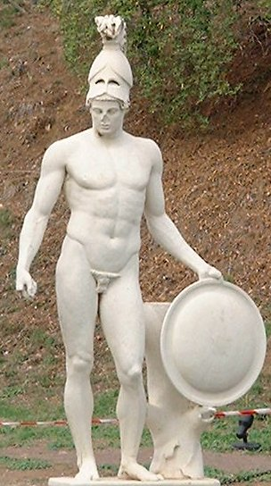
ARES
Sacred animals- woodpecker, vulture, eagle owl, dog
His sister Hebe drew baths for him
killed Halirrhothius
  son of Poseidon who raped his daughter Alcippe
  Poseidon put him on trial with a council of gods on the Acropolis
  Ares was acquitted, and the hill became known as the Areopagus (Rock of Ares)
Gigantomachy
  was kidnapped by the Aloadae
    two giants- Otus and Ephialtes
    trapped him in a bronze jar for 13 months until their stepmother Eriboea told Hermes, who rescued Ares
  killed Mimas
owned the Stymphalian birds
  had bronze beaks, poisonous dung, and could shoot their sharp metallic feathers
  Heracles cleared them out of Arcadia for his Sixth labor
    they had fled to Arcadia from a pack of wolves and were destroying crops and people
    used a rattle made by Hephaestus to scare them out of a marsh, then shot them with his Hydra blood arrows

Slide 10
ARES
was wounded by Diomedes in the Trojan war
  Ares helped the Trojans, and Athena guided Diomedes’ spear at Ares’s stomach, causing him to roar and scare all the soldiers
caught in a net with Aphrodite by Hephaestus
  Helios told Hephaestus of their affair, so he crafted an invisible gold net to snare them in
    Ares had told Alectryon to wait at the door to the hall of Hephaestus to warn of Helios’s coming, but he fell asleep and Ares turned him into a rooster, which now warns of the coming of the sun at dawn
Attendants
  Alala- “war cry”
    daughter of Ares’s other attendant Polemos- embodiment of war
    alternatively, one of the Makhai
  the Makhai (or Machae)
    children of Eris
  Enyo and Eris
Has many children with notable stories of their own, including Harmonia, Enyalius, Cycnus, Ascalaphus, Oenomaus, Penthesilea, and Tereus

Slide 11
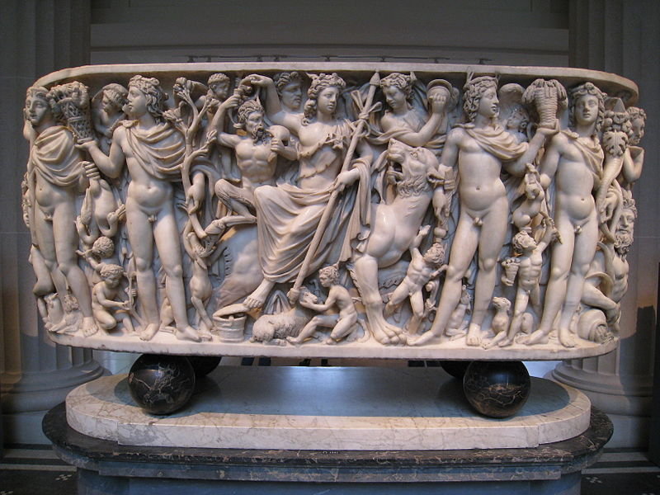
Dionysus
son of Semele and Zeus
  Hera appeared to her as a crone and made her doubt that Zeus was really the father of her unborn child
  Semele demanded Zeus appear to her in his godly form, which he pleaded with her not to demand, but she insisted and perished in the ensuing godly splendor
  Zeus recovered Dionysus from the burnt remains of Semele and sewed him into his thigh and released him on Mount Pramnos on Ikaria
  therefore, Dionysus is known as "twice-born"
  Alternatively, he is the son of Zeus and Persephone (Cretan version)
    Hera sent the Titans to lure the infant Dionysus with toys and then rip him to pieces
    The Titans mocked him by giving him a thyrsus (fennel stalk) in place of his scepter
      had a pinecone on top
    The Titans ate everything except his heart, which Zeus used to recreate him by either sewing it into his thigh, planting it in Semele's womb, or giving it to Semele to eat
      the first pomegranate tree sprouted up where his blood fell

Slide 12
Dionysus
Grew up in Nysa
  far-away place that was variously associated with Ethiopia, India, Libya, Arabia, or Tribalia
    Dionysus allegedly founded a city on the Indus named Nysa, which Alexander the Great arrived at
  Hermes took him there to be raised by rain-nymphs who were later turned into the Hyades by Zeus in gratitude
  Alternatively was raised by Athamas and Ino (sister of Semele)
    Hera struck Athamas with madness, causing him to kill his own son Learchus
    Ino threw herself into the sea with her son Melicertes to escape Athamas, and they became sea deities
Was driven mad by Hera after inventing wine
  had his madness cured by Rhea (or Cybele)
Abduction by pirates
  sailors kidnapped him and tried to tie him up with rope, but no ropes could hold him
  he turned into a lion and unleashed a bear, causing sailors to jump overboard, which he turned into dolphins
  spared the helmsman Acoetes, who recognized him from the start and tried to warn the other sailors
    pilot from Maeonia who became a devotee of Dionysus
  in another story, he hired Tyrrhenian pirates to take him from Icaria to Naxos, but they sailed to Asia to sell him as a slave
  he turned the oars and mast into snakes, filled the ship with ivy and the sound of flutes to drive the pirates mad, causing them to jump into the sea and turn into dolphins

Slide 13
Dionysus
Orphic tradition
  worshipped as his incarnation Zagreus
  story where his heart was fed to Semele
  took the form of a bull in the omophagia
    his followers would tear it apart as Dionysus had been and ate the raw flesh
    referred to as Taurokeros or Tauroprosporos
Midas
  found Dionysus’ tutor Silenus drunk and recognized him, then entertained him with hospitality at his palace for ten days and nights
  returned him to Dionysus, who offered Midas whatever he wanted
  Midas chose to turn everything he touched into gold, but Dionysus agreed but wished he made a better choice
  He regretted it after his food, drink, and daughter all turned to gold, and prayed to Dionysus to deliver him from starvation
  Dionysus told him to wash in the river Pactolus
  the sands in the river turned to gold, explaining the richness of gold found there

Slide 14
Dionysus
Lycurgus
  Thracian king of Edoni who imprisoned the Maenads when he heard Dionysus was in his kingdom
  Dionysus fled and took refuge with Thetis
  sent a drought to make the people revolt, and drove Lycurgus mad, making him think his son Dryas was an ivy plant (Dionysus’ sacred plant), who he then hacked to death with an axe
  an oracle then prophesied that the drought would continue as long as Lycurgus was alive, so the people had him drawn and quartered
Pentheus
  story from Euripides’ The Bacchae
  cousin of Dionysus and ruler of his birthplace of Thebes
  Dionysus want revenge on Pentheus and the women of Thebes for doubting that his mother was impregnated by Zeus, and for denying his own divinity and worship
  drives Pentheus mad and lures him to Mount Cithaeron to spy on the Maenads
  they mistake him for a wild animal and tear him apart
    his mother Agave tears off his limbs as he begs for his life

Slide 15
EGYPTIAN
Know the major city theologies and their deity groups:
  Ennead: 9 gods, Heliopolis- Atum, Shu, Tefnut, Geb, Nut, Osiris, Isis, Set, Nephthys
  Ogdoad: 8 gods (4 male-female pairs), Hermepolis- Nu & Nut, Heh & Hauhet, Kek & Kauket, Qerh & Qerhet
  Memphite theology- revolved around Ptah, detailed in Shabaka Stone
Also know: Ra, Horus, Hathor/Sekhmet, Anubis, Thoth
Minor gods: Apep, Hapi, Khnum, Sobek
Story arcs- Murder of Osiris, conflict between Set and Horus

Slide 16
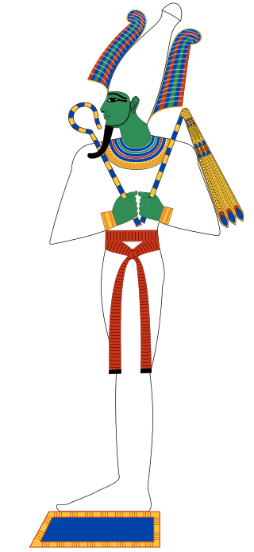
OSIRIS
Cult center at Abydos
Djed column represents his backbone
Depicted with wheat growing out of his body
Syncretized with Apis in the Hellenistic Serapis
His soul was worshipped as a deity in its own right- the ram god Banebdjedet
Sealed in a coffin by his brother Set
  Thrown in a river and floated down the Nile and somehow became embedded in a tree trunk, which was then used as a column in a palace at Byblos
  Resurrected by Isis using a spell taught to her by her father Geb
    Osiris impregnated her with Horus before dying again
  Alternatively Isis hid the body in the desert, but Set found it when he was out hunting and tore it into fourteen pieces in rage
    his penis was eaten by the oxyrhyncus fish, so Isis replaced it with a golden one
      Isis collected the remaining pieces, and with the help of Thoth and Anubis, bandaged Osiris back together and resurrected him, allowing the couple to conceive Horus
  In some accounts, Isis fans life into him in the form of a kite or falcon
  after dying again, he becomes ruler of Duat
held the epithet Khenti-Amentiu, meaning "Foremost of the Westerners"
  westerners refers to the dead
  this was also given to Anubis

Slide 17
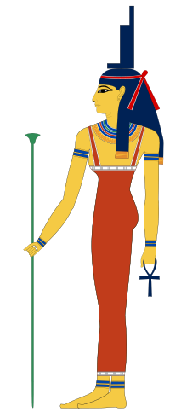
ISIS
depicted with a throne headdress
worshipped at Behbeit El-Hagar and the island of Philae
the tyet is her knot
  also referred to as the Blood of Isis, and funerary amulets of it were made of red stone, wood, or glass
four of her children protected the canopic jars
created a snake to bite Ra and refused to give him the antidote unless he told her his secret name

Slide 18
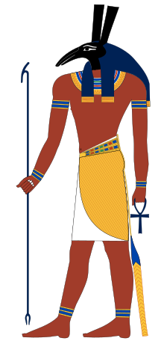
SET
Brother of Osiris and rival of Horus
Was tricked into eating lettuce covered in Horus’s semen
Was tricked into building a boat of stone in a race in which Horus painted his boat to look like stone
There is controversy as to what animal’s head he’s depicted with, some say it’s a giraffe or an aardvark
protected Ra’s sun barge every night
husband of Nephthys

Slide 19
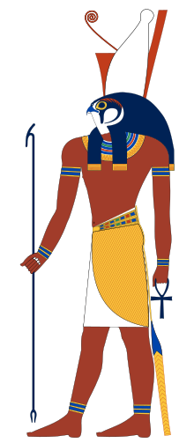
HORUS
rasied in Chemnis
had four sons- gods of the cardinal directions and canopic jars (note- listen to the question to tell between Horus and Isis on the clue)
Greeks called him Harpocrates
tore off Set’s genitals- explains infertility of the desert
often depicted as a child holding a finger to his mouth
sometimes referred to as Mekhenty-er-irty
conceived by either a golden phallus or divine fire
got his severed hands back after Sobek invented the fish trap
Isis accidentally harpooned him
identified with crocodile god Khenty-Khety
killed a lot of crocodiles and hippos

Slide 20
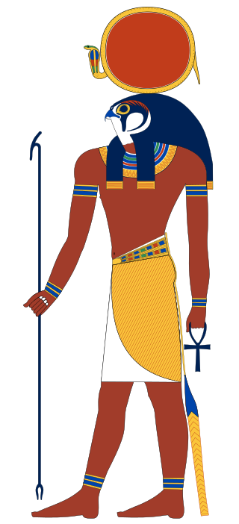
RA
Soul was represented by the Bennu bird
Associated with the Mnevis bull
Associated with the dung beetle Khepri
Put Sekhmet to sleep by disguising beer as blood
Rides through Duat every night on his sun barge, fights the serpent Apophis/Apep in the form of a cat
  owned two barges- Mandjet (morning boat) and Mesektet (evening boat)
  aided by Set and Mehen
Isis created a snake to bite Ra and refused to give him the antidote unless he told her his secret name, thus giving her his power

Slide 21
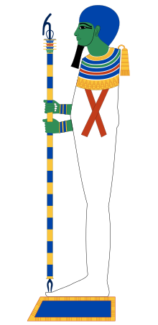
PTAH
syncretized with the funerary deity Sokar/Seker and the land god Tatenen
identified with Hephaestus/Vulcan
wears a skull cap
father of Imhotep
Shabaka Stone- describes Memphite theology, places him as creator
originally associated with the Apis bull

Slide 22
NORSE
Know the major Aesir: Odin, Frigg, Thor, Loki, Heimdall, Baldr
Major Vanir: Freyr and Freyja
Also know participants and major figures in the stories of Baldr’s Death, the castle of Utgard-Loki, the Aesir-Vanir War and Ragnarok
Recommended texts: the Eddas, Sagas (particularly Yngling and Volsung)

Slide 23
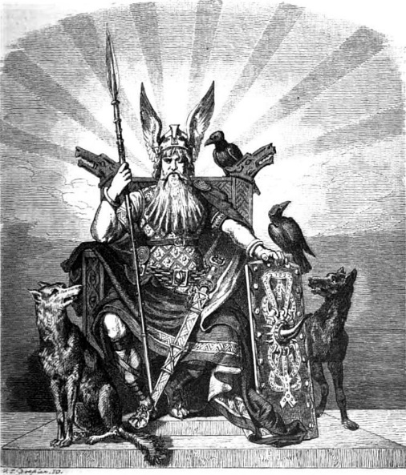
ODIN
Possesions:
  Gungnir- spear that never misses
  Draupnir- ring that multiplies itself; makes eight identical rings every ninth night
  Sleipnir- eight-legged horse whose teeth are inscribed with runes
  Huginn and Muninn- ravens that fly around the world and tell Odin what is happening
  Geri and Freki- wolves Odin gives his food to
  Hlidskjalf-high throne from which Odin can see all the realms
Valhalla- Odin’s third hall, the destination of all those who die in combat
Stories
  Created the world with his brothers Vili and Ve out of the body of the giant Ymir, whom they had killed
  Gives life to two logs that become the first humans- Ask and Embla
  Hung himself from Yggdrasil for nine days while pierced with his own spear to gain knowledge of the runes
  Gave an eye to gain knowledge from the Well of Mimir
  Stole the Mead of Poetry during the events of the Aesir-Vanir War
  Will be swallowed by Fenrir at Ragnarok

Slide 24
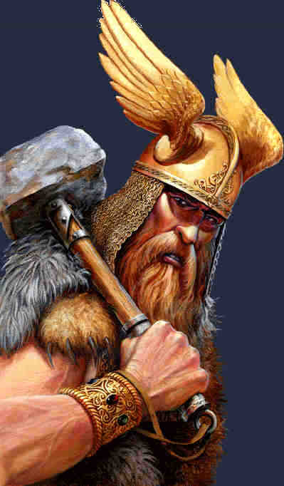
THOR
Possesions:
  Mjolnir- hammer which can only be handled with one hand
  Megingjord and Jarngreipr- belt and gloves used to lift Mjolnir
  Tanngrisnir (teeth-barer) and Tanngnjostr (teeth-grinder)- goats that pulled his chariot, could be killed and eaten, then revived with Mjolnir the next day
  Thjalfi and Roskva- his servants, gained after Thjalfi ate the bone marrow of one of the goats, resulting in its lameness upon resurrection
Stories:
  Rivalry with Jormungandr
    Went fishing for the world serpent with the giant Hymir using an ox head, but Hymir cut the line before Thor could kill it with Mjolnir
    Will kill Jormungandr at Ragnarok, but will die after taking nine steps from the serpent’s venom
  Has part of the giant Hrungnir’s whetstone lodged in his forehead
  Caused the dwarf Alviss to turn to stone by making him talk all night until he sun rose
  At Utgard-Loki’s castle: Failed to lift a cat’s paw, empty a drinking horn, and wrestle an old woman

Slide 25
HINDU
Know the Trimurti: Brahma, Vishnu, and Shiva
  Also know their wives: Saraswati, Lakshmi, and Parvati
  Know Vishnu’s avatars
Know the major Vedic gods: Indra, Agni, Varuna, Surya
Also know: Ganesha, Kali, Hanuman, Kama
Be familiar with the story of the Churning of the Ocean
Recommended texts: the Mahabharata, the Ramayana, the Rig Veda

Slide 26
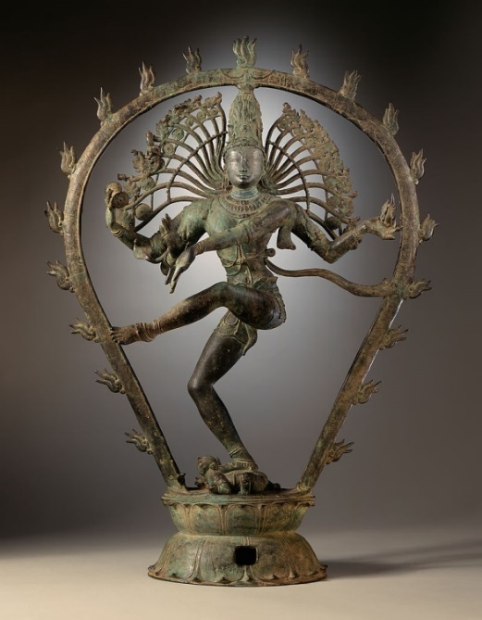
SHIVA
In Vedic Myth he is named as Rudra
Lives on Mt. Kailash
consumed Halahala during the Churning of the Ocean, which turned his throat blue
rides the white bull Nandi
symbolized by the phallic lingam in temples
Has matted hair from which the Ganges flows
head is decorated with the crescent moon
he smears his body with ashes (bhasma)- symbolizes humans’ final fate
wields the Trishula trident
served by the Ganas
wears a garland of snakes- the Nagendra Haara
often depicted in Nataraja form (Lord of the Dance)- steps on the dwarf Apasmara (aka Muyalaka), asura of ignorance
possesses Damaru (a drum) which provides the beat of the universe-shaped like an hourglass

Slide 27
SHIVA
Dakshinamurthy- aspect of Shiva as a guru- means “one who is facing south”
in the form of Kalantaka (Ender of Death) he kills Yama, the Lord of Death, when he comes for the soul of Shiva’s devotee Markandeya
  Markandeya had been given to his father Mrikandu by Shiva as a virtuous son on the condition that he would only live 16 years
  Brahma taught him the Mahamrityunjaya Mantra- a mantra that extends life, and Markandeya worshipped the linga. The other gods pleaded with Shiva to extend his life, and he did
  Yama came for Markandeya, but he told Yama that it would be an offense to Shiva
  Yama replied that not even Shiva could save him, and threw his lasso around Markandeya as he clung to the linga
  when the lasso touched the linga, Shiva appeared as Kalantaka, smacked Yama with his trident, and kicked him in the chest, killing him
  Shiva later had to revive Yama by touching him with his foot as without death, earth became polluted with evil things that wouldn’t die
Ardhanarisvara- half-male, half female form (split down the middle)
Third Eye

Slide 28
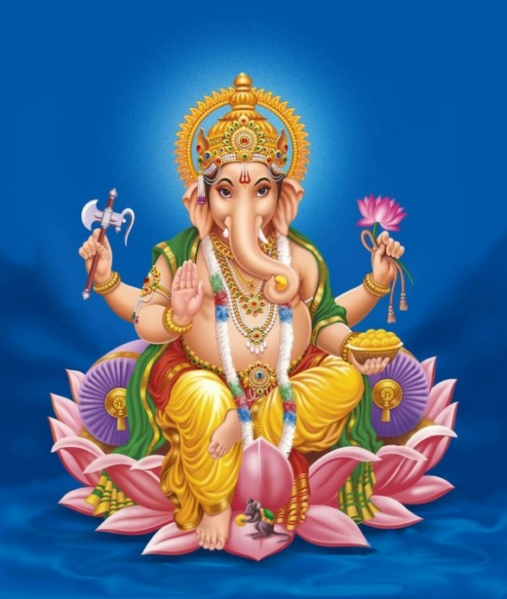
GANESHA
“Remover of obstacles"
Son of Shiva and Parvati
  Created out of clay by Parvati to guard her
    Shiva beheaded him when he came between him and Parvati, then replaced his head with an elephant’s
  Alternatively, created from Shiva's laughter
  In another story he gets his elephant head after Parvati asked Shani to look at her son, and his gaze burned his head off. Vishnu then flew off on Garuda to fetch an elephant head
Holds an axe, whip(or noose), lotus, and his broken tusk
  Alternatively a mace, discus, shell, and lily
Left tusk was severed by Parashurama
  Parashurama was travelling to the Himalayas to pay homage to Shiva but Ganesha blocked his path
  Parashurama threw his axe Paraśu at Ganesha, who allowed it to sever his tusk because it was a gift from Shiva
  Ganesha's mother Parvati flew into a rage, transforming into her omnipotent form Durgama, but Shiva talked her down
  Parashurama asked her forgiveness, and Ganesha defended him and received Paraśu
Shiva and Parvati challenged him and his brother Kartikeya (aka Murugan or Skanda) to race around the world three times (in some accounts it is for a divine fruit of knowledge from Narada, in others it is to marry Buddhi and Siddhi)
  Kartikeya set off on his peacock, and Ganesha realized he couldn't outpace him on his mouse
  He instead circumnavigates his parents three times, realizing that they are the universe

Slide 29
GANESHA
Feast at Kubera's Palace
  Kubera, god of wealth, invited Shiva to a banquet at his city of Alakapuri to show off his wealth. Shiva declined but offered to send his son in his place, warning Kubera that he had a voracious appetite
  Ganesha kept eating all the food and then began eating the decorations and furniture
  Kubera pleaded with him not to eat everything, but Ganesha threatened to eat Kubera if he wasn’t given more food
  Kubera asked Shiva for help, and Shiva gave him a handful of roasted rice- anything can satisfy Ganesha's appetite if offered with love and humility
  Ganesha had eaten like half the city before Kubera got back
Moon Incident
  on the way back from Kubera's feast, a snake scared Ganesha's mouse and he fell off and his stomach burst open, spilling food everywhere
  Ganesha began putting the food back in, but the moon laughed at him
  Ganesha cursed the moon to never be seen, but the moon begged for mercy, so he made it go through cycles from new to full, and if anyone saw him on Ganesha's birthday, that person won't achieve moksha
  Ganesha then used the snake to tie up his belly

Slide 30
MAHABHARATA
Written by Vyasa
Its plot centers on the power struggle between the Kaurava and Pandava princes. They fight the Kurukshetra War for the throne of Hastinapura, the kingdom ruled by the Kuru clan.
As per legend, Vyasa dictates it to Ganesha, who writes it down
Divided into 18 parvas and 100 sub-parvas
Bhagavad-Gita
  Contained within the Mahabharata
  It is the story of Krishna reminding Arjuna of his duty while the two are waiting for the Battle of Kurukshetra to occur
  Takes place on the Field of Kuru
  Other than Arjuna and Krishna it has two other characters: King Dhritarashtra and his counsellor Sanjaya
  Made up of 18 chapters and is in the sixth parva of the Mahabharata
  Yoga is an important part of this text
  “Renouncing Fruits of Works”
  Has a bunch of “Religion by” parts
  “Performance of prescribed duties, but without attachment to results”
  Describes absolute reality and its illusory energy as Maya
  Describes the importance of the last thought before death
  Krishna displays his “universal form;” a form in which he is facing every direction and is really fucking bright
  Explains the three modes (Gunas) if material nature
  Krishna describes a metaphorical tree with its roots in Heaven and its foliage on Earth. Said tree should be cut down with an “axe of detachment” after which one can go to his “supreme abode”
  Krishna explains how eating habits correspond to the three modes (Gunas)

Slide 31
SHINTO
Know the major kami: Izanagi, Izanami, Susanoo, Amaterasu
Also know: Tsukuyomi, Raijin, Ryujin, Sarutahiko, Fujin, Okuninushi, Inari
Major story arcs: creation of the world, Izanami’s death, Amaterasu in hiding
Recommended texts: the Kojiki, Nihon Shoki

Slide 32
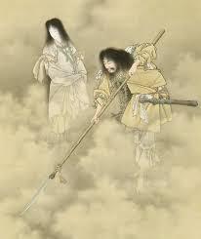
IZANAGI and IZANAMI
Male and female creator gods, respectively, stirred the primordial waters using a spear (Amenonuhoko), the water dripped from the spear created an island
They lived on this island and performed a ritual rounding a pole, Izanagi to the left, Izanami to the right, she greets him first, this was performed for having children
Two first children were imperfect from incorrect rituals and cast out
  First child Ebisu- born a “Leech Child” he later grew legs and a skeleton and became the god of fishermen
They then birthed the eight main islands of Japan, a paradise ordained for the Japanese people (the creation is called kuniumi)
Izanami gives birth to the fire kami Kagu-tsuchi who burns her to death (she is buried on Mt. Hiba). Izanagi cuts him into eight pieces with his sword (Totsuka-no-Tsurugi or Ame-no-Ohabari which later becomes Susanoo’s). The pieces become volcanoes, and his blood spawns eight kami
Izanagi ventures to Yomi-no-kuni (the underworld) to try to bring Izanami back, but she has eaten food there and cannot leave

Slide 33
IZANAGI and IZANAMI
Izanagi had promised not to look at her, but sets his comb alight to see her anyway. He sees her rotting, maggot-infested form and runs away. Izanami sends Raijin and the hag(s) shikome after him, but he rolls a boulder over the entrance to Yomi (which is in Ifuya Pass). Izanami avows to kill 1000 of the living every day if he leaves her, and he retorts that 1500 shall be born every day.
Izanagi then purified himself of the pollution of Yomi, creating many kami (kamiumi) including Amaterasu, Tsukuyomi, and Susanoo

Slide 34
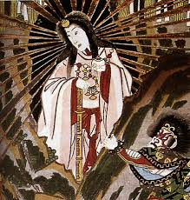
AMATERASU
Sun goddess, emperor of Japan is descended from her
Rubbed from Izanagi’s left eye
Used to share the sky with her husband Tsukuyomi until he killed the food goddess Uke Mochi out of disgust. She labeled him as evil and separated herself from him, creating day and night
When Izanagi ordered Susanoo to leave heaven, he bid her goodbye, but she doubted his sincerity. To prove it, Susanoo proposed a challenge in which they took an object of the other and birthed people from it. He birthed five men from her necklace, she birthed three women from his sword; she claimed victory because her item had produced men.
Her rice fields were destroyed by Susanoo when he went on a rampage; he then threw a flayed pony at her loom and killed one of her attendants. She hid in the cave Ama-no-Iwato, thus hiding the sun. The goddess of merriment, Ame-no-Uzume, placed a mirror (Yata no Kagami) on a tree outside the cave, then danced on an upturned tub, drumming her feet. She then got naked, which made the other gods laugh, so Amaterasu went out to see what was going on. The ray “dawn” escapes, and Amaterasu is amazed at the beautiful goddess she sees, which is her own reflection in the mirror. While she is astonished, she is grabbed from the cave, which is sealed with a shimenawa (a type of rope).

Slide 35
AMATERASU
She gave her grandson Ninigi, the great-grandfather of Jimmu, first Emperor of Japan, the Three Imperial Regalia: Yata no Kagami (mirror), Yasakani no Magatama (jewel), and Kusanagi-no-Tsurugi (sword)
Worshipped at the Ise shrine
  Torn down and rebuilt every 20 years

Slide 36
ALSO CHECK OUT
These are just a few of the myth systems commonly tossed up in quizbowl, but expect others you may not be familiar with, especially on higher difficulties like nationals!
If you are interested in world myth, check out Irish, Finnish (Kalevala), Russian/Slavic, Native American (esp. Inuit), Mayan, Aztec, Inca, Chinese, Polynesian, and West African

